Slide 1
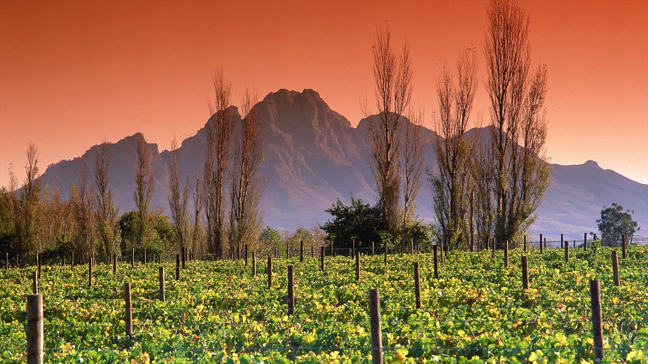
WE / GRO / YOU
PRIVATE BRIEF · FRANSCHHOEK · MAY 2026
The Valley of Life.
A campus held in public interest.
For chefs. For rangers. For the next generation of Franschhoek.
Prepared for · Hein Koegelenberg

Slide 2
WE / GRO / YOU
02 / 16
ONE QUESTION
What does Franschhoek leave
to the next generation?
Wine, restaurants, beauty — and a quiet drift of valley youth out of the valley.
This brief proposes one institution that holds them here, trains them, and sends them out as professionals on the world stage. Chefs. Rangers. Founders. Carrying La Motte's lineage. Carrying InHarmonie's spirit.

Slide 3
WE / GRO / YOU
03 / 16
THREE SCALES · ONE MISSION
You already do this. We can scale it.
01 · The estate
02 · The community
03 · The institution
La Motte
InHarmonie
WeGroYou Campus
Three centuries of French heritage. Wine, music, art, healthcare, education. The valley's reference point for excellence.
Music, mentorship and youth development inside the valley. Proof the next generation responds when the platform exists.
A permanent campus. Takes chefs, rangers, athletes and founders from the valley and shapes them for the world stage.

Slide 4
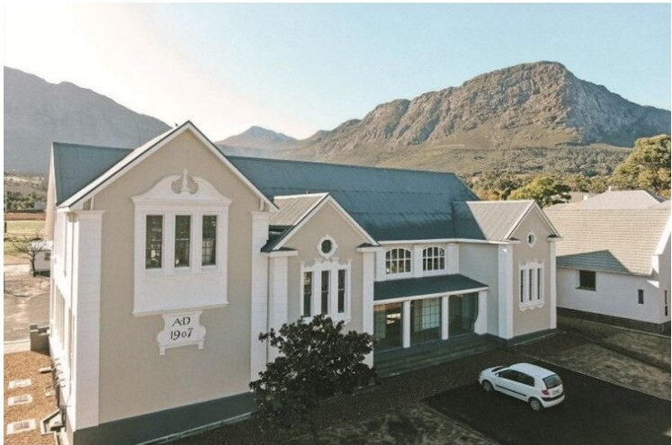
WE / GRO / YOU
04 / 16
THE CAMPUS
15 Union Street.
AD 1907.
A heritage building inside the village. Currently leased by Train Camp (Pty Ltd, Wim Fourie). On day one of this brief, that lease ceases to be private property.
→ Lease cedes to a WeGroYou NPC + Co-op
→ Hospitality / chef / ranger academies on site
→ Hotel + co-working + school + ventures under one roof
→ The village pours back into the campus and back out

Slide 5
WE / GRO / YOU
05 / 16
CHAPTER ONE · CHEFS
The Franschhoek
Hospitality Academy.
Where valley youth become professional chefs — and carry La Motte's lineage into every kitchen they touch.

Slide 6
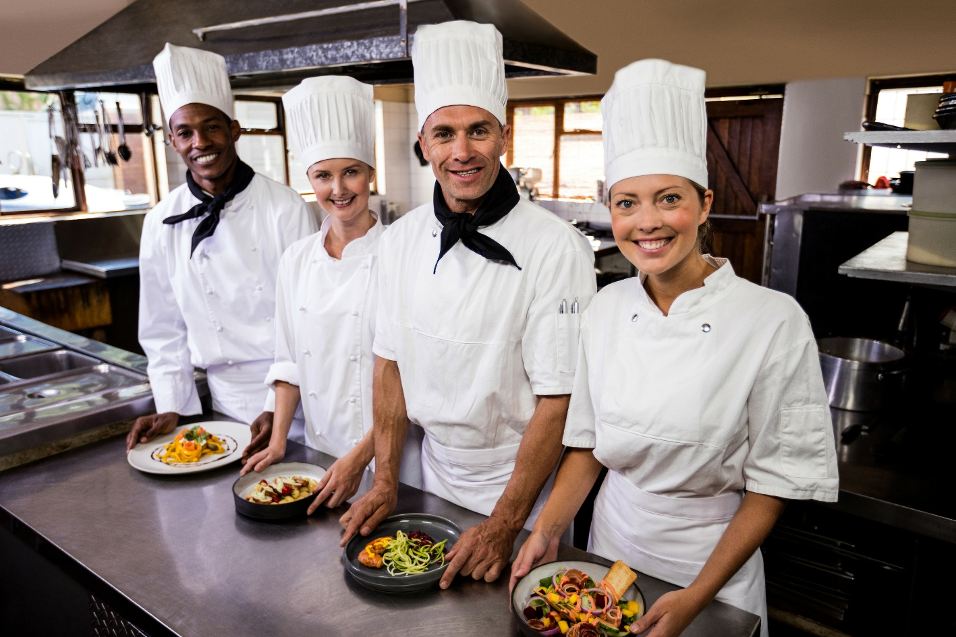
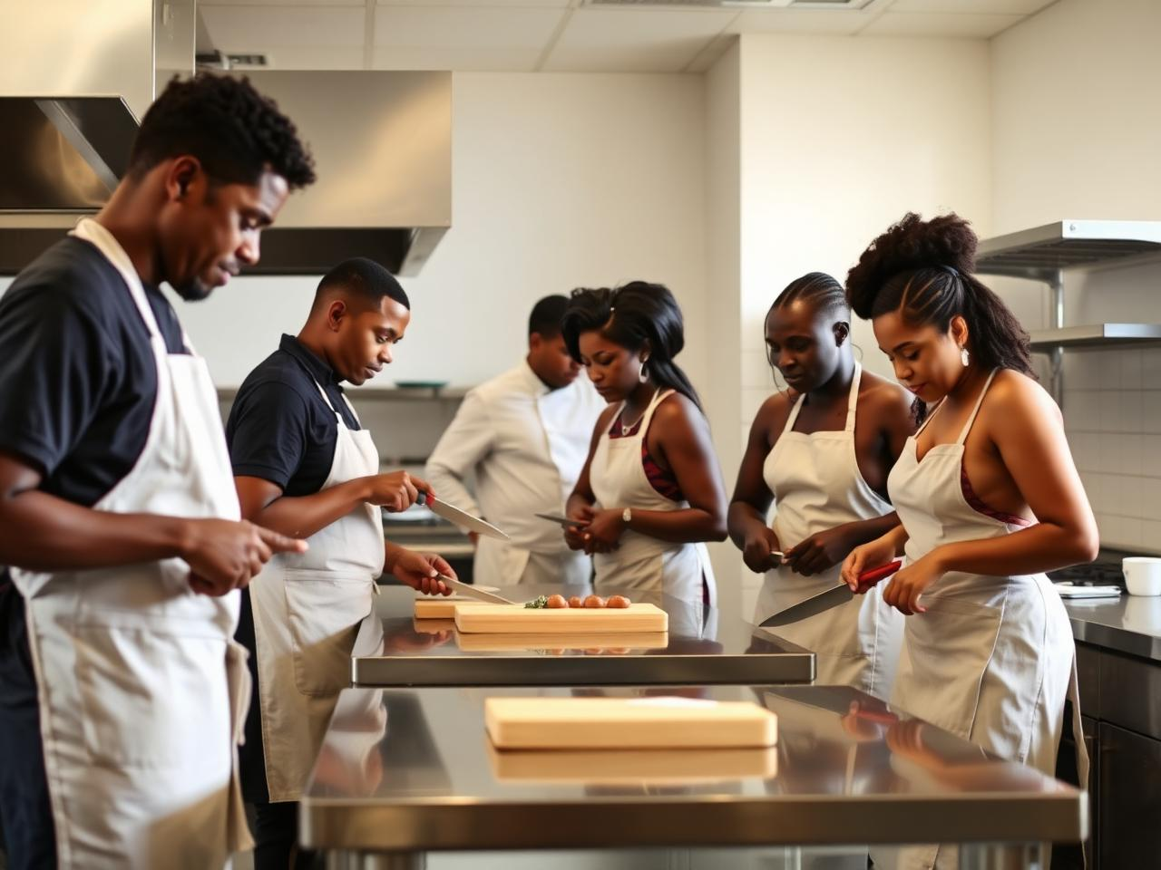
WE / GRO / YOU
06 / 16
THE CHEF PROGRAMME
Curriculum, kitchen, and a lineage.
Pipeline
Valley youth · WeGroYou Basic School cohort · open intake from Western Cape schools.
Curriculum
Classical foundations · South African terroir · wine pairing taught with La Motte · stages in the valley's restaurants.
Outcome
Professional chefs employable from Franschhoek to London. Annual La Motte × WeGroYou showcase on campus.

Slide 7
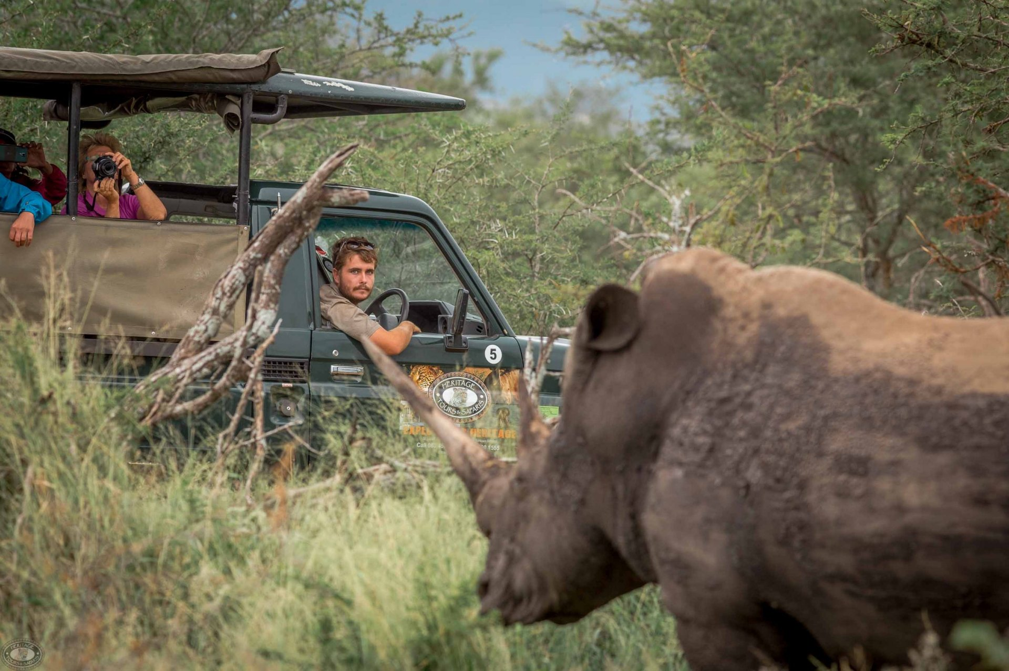
WE / GRO / YOU
07 / 16
CHAPTER TWO · RANGERS
Conservation
as a career.
Where the valley's love of land becomes a profession — and a national network.

Slide 8
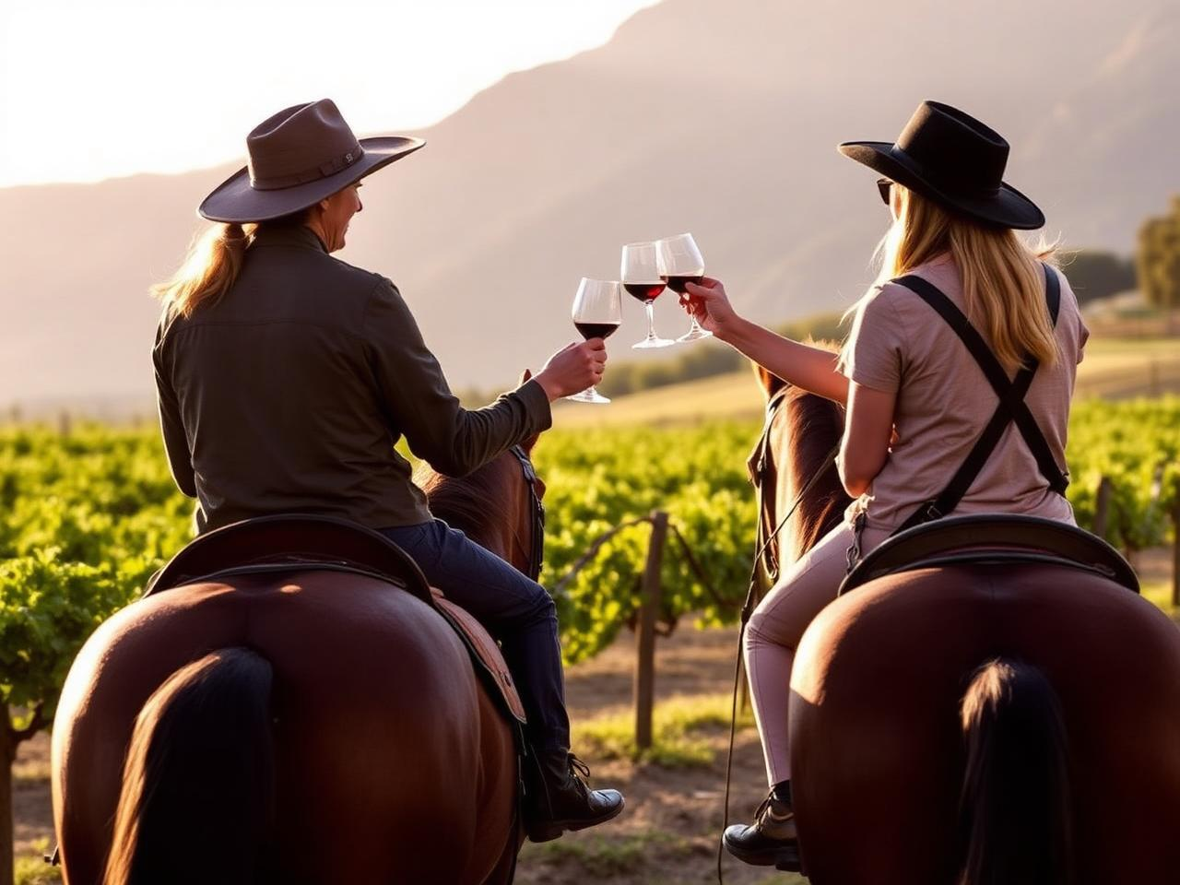

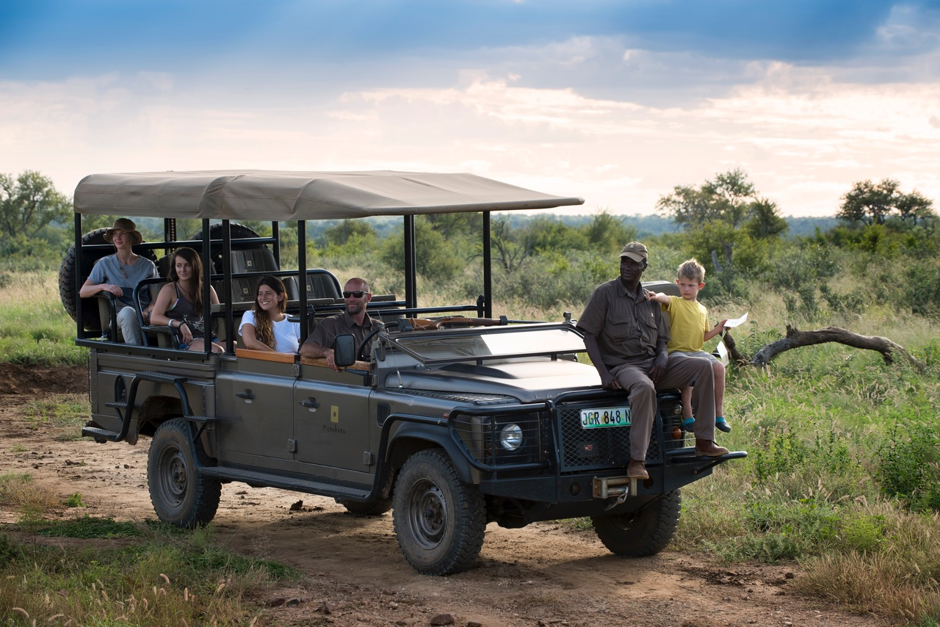
WE / GRO / YOU
08 / 16
THE RANGER PROGRAMME
FGASA pathways. Real reserves. Real jobs.
Pipeline
Valley youth + Cape Winelands schools. No background in the bush required.
Curriculum
FGASA pathways · tracking, anti-poaching, hospitality on the reserve · field placements through the WeLoveParks network.
Outcome
Working rangers in private reserves and national parks across SA. A second route out of the valley that does not require a passport.

Slide 9
WE / GRO / YOU
09 / 16
VALLEY UPLIFT
A permanent channel
back to the valley.
5% of campus revenue
endowed in perpetuity to valley youth programmes.
Channelled through the Education & Growth Foundation SA. InHarmonie partnership programme runs inside the campus. Permanent. Cannot be reversed without a 75% NPC supermajority vote.

Slide 10
WE / GRO / YOU
10 / 16
THE WHOLE PICTURE
Six engines. Two are yours. The others carry the campus.
Hotel & Hospitality
Basic School
Chefs Academy
Campus revenue engine. 7-day cashflow.
Model C, on-premises. 700 → 20,000 learners over 5 years.
Your interest. La Motte lineage. Valley pipeline.
Rangers Academy
Sportif
Wegro Ventures
Your interest. FGASA pathways. WeLoveParks network.
Hybrid sport-tech R&D + athlete development.
Keeps valley founders in the valley.

Slide 11

WE / GRO / YOU
11 / 16
ENTREPRENEURS
Keep the valley's
founders in the valley.
Wegro Ventures gives the valley's founders a co-working campus, mentor pool, and a path to capital — without leaving for Cape Town or Stellenbosch.
Most will be from outside the chef and ranger pipelines. They sit alongside, share the same canteen, the same library, the same bell. The cross-pollination is the point.

Slide 12
WE / GRO / YOU
12 / 16
GOVERNANCE · STEWARDSHIP NOT CONTROL
It is not yours. It is the valley's.
Education & Growth Foundation SA
YOUR SEAT
Public-interest PBO. Holds equity-pledge contracts from every incentivised party.
Founding sponsor seat at the NPC + Co-op.
WeGroYou NPC + Co-op
Holds the lease, the campus, the school and the IP pool. One member, one vote. 7-director board.
Permanent. Named. With a legacy plaque on the AD 1907 building. Voice on reserved matters. Not a controlling stake — by design.
ManCo (Pty Ltd) · Wim Meyer
Day-to-day operator. Replaceable on 6-month notice by 75% NPC vote.
The campus + 6 engines
Hotel · School · Chefs · Rangers · Sportif · Ventures.

Slide 13
WE / GRO / YOU
13 / 16
THE RULE ABOVE THE RULES
Where the upside goes.
Every share offered as an incentive — to ManCo, operators, brokers, anyone — sits inside or pledges back to a public-interest education foundation. Formed or nominated. Board appointed jointly by the NPC and the founding sponsor seat.
INCENTIVE
PLEDGE TO THE FOUNDATION
ManCo founders' equity (10%)
25% of any exit or dividend → Foundation
Wegro Ventures carry (10%)
25% of carry on every realised exit → Foundation
Vertical operator equity
10% of operator equity issued at incorporation → Foundation
LifeStone broker fee
100% routed via Foundation on exit (sunsets year 3)
Patron donations
100% to NPC; education-tagged portion held by Foundation

Slide 14
WE / GRO / YOU
14 / 16
WHAT WE ARE ASKING FOR
Three options. Smallest to largest.
Each tier is fully donated through the Education & Growth Foundation SA. None of it returns to LifeStone, ManCo or any private party.
PATRON
CORNERSTONE
VALLEY LEGACY
R5–10m
R20–30m
R50m+
Founding-tier philanthropy. Quiet, named, legacy-marked.
Anchor donor for the chef vertical. La Motte = wine + culinary partner.
Anchors the chef vertical AND endows the valley uplift channel forever.
✓ Names the Hospitality Academy intake hall
✓ Founding sponsor seat at the NPC + Co-op
✓ Permanent legacy plaque on the AD 1907 building
✓ Names the Franschhoek Hospitality Academy
✓ La Motte as the campus wine + culinary partner
✓ Annual La Motte × WeGroYou chef showcase
✓ Founding sponsor seat (permanent)
✓ Everything in the Cornerstone tier, plus:
✓ InHarmonie partnership inside the campus
✓ 5% campus revenue endowed in perpetuity
✓ Founding seat on the Education & Growth Foundation

Slide 15
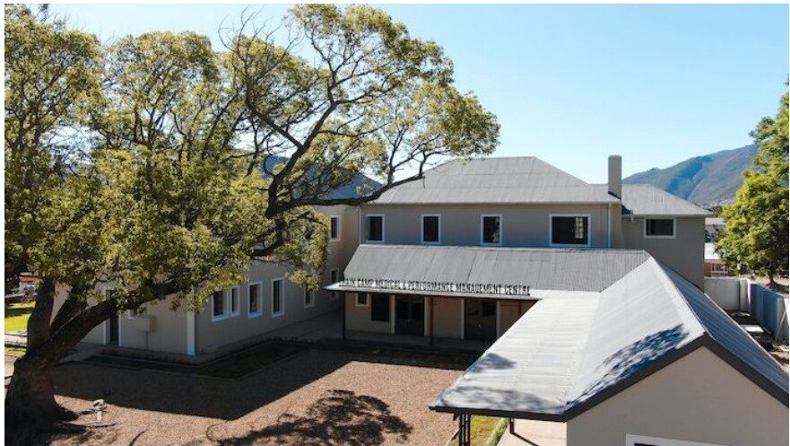
WE / GRO / YOU
15 / 16
NEXT STEP
A 90-minute
walk-through.
On site. With Wim Meyer. The building, the chef school plan, the academy curriculum, the NPC structure on paper. No deck. No pressure. Just a walk through what is possible.

Slide 16
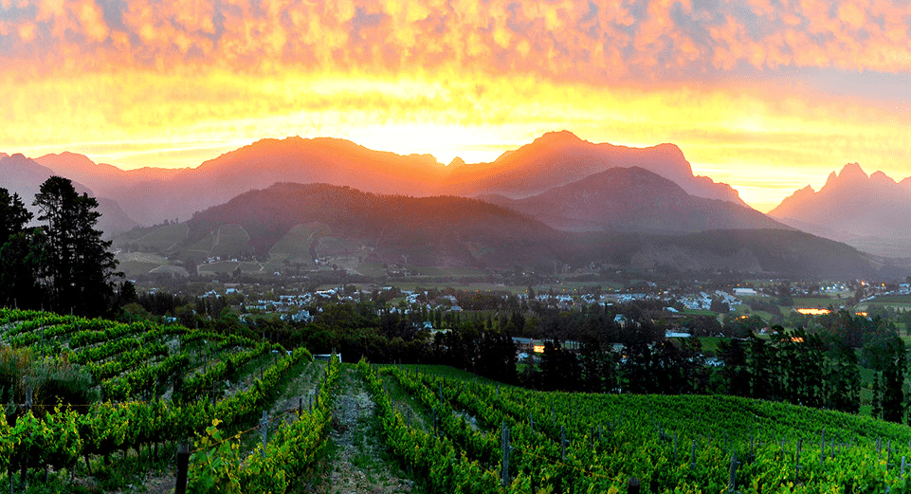
WE / GRO / YOU
16 / 16
FOR HEIN
The valley should be
the place of LIFE.
wim@wegroyou.com · wegroyou.com/pitch/valley-of-life · Private brief — do not redistribute.

