Slide 1
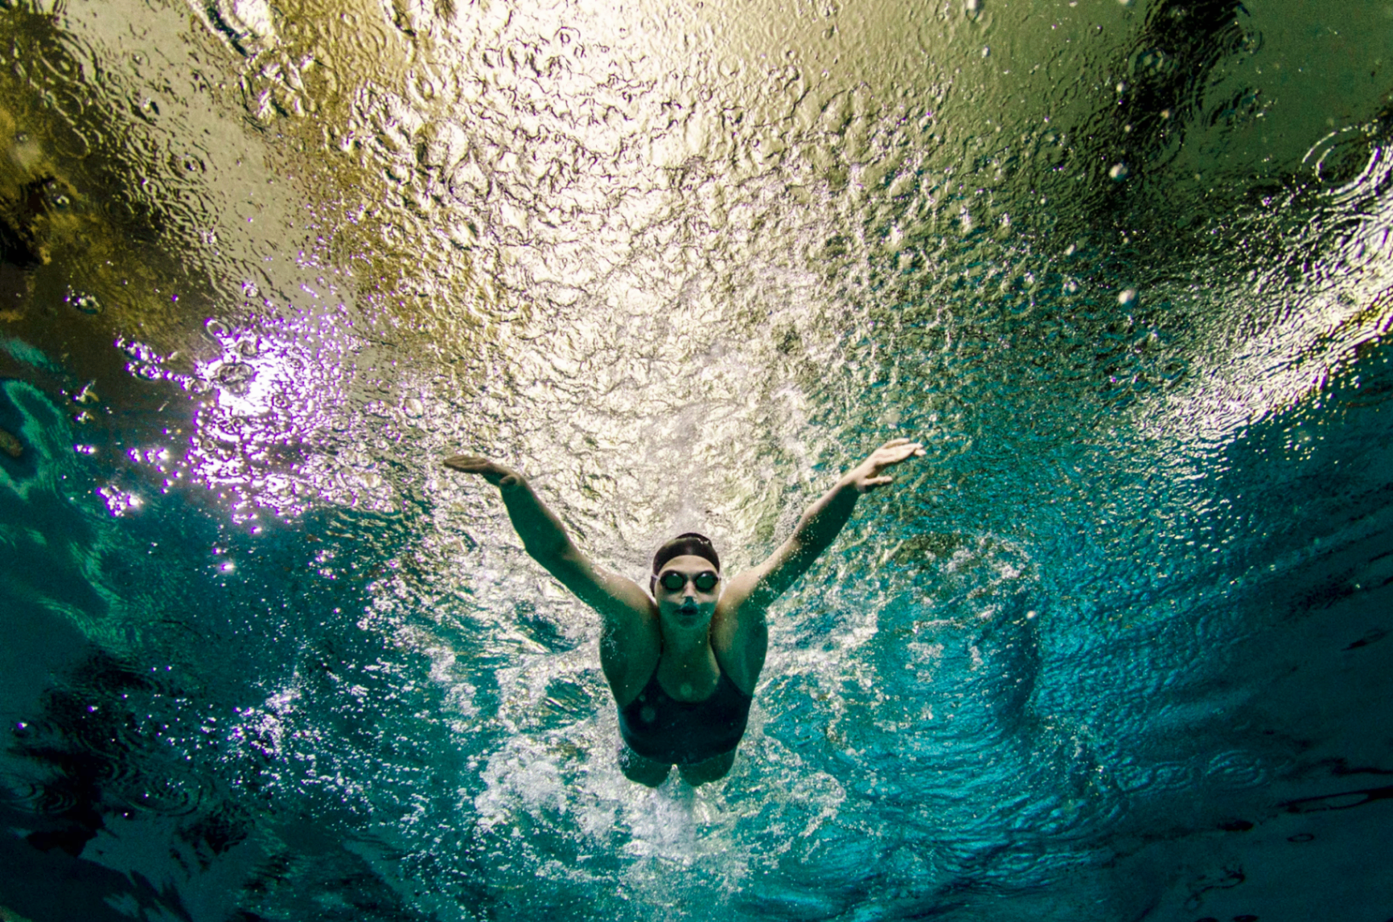

WEGROYOU · FRANSCHHOEK CAMPUS · INVESTOR DECK 2026
Where world-class humans are built.
SPORT · FOOD · BUSH · WATER · VENTURE — ONE CAMPUS, ONE OPERATING SYSTEM

Slide 2
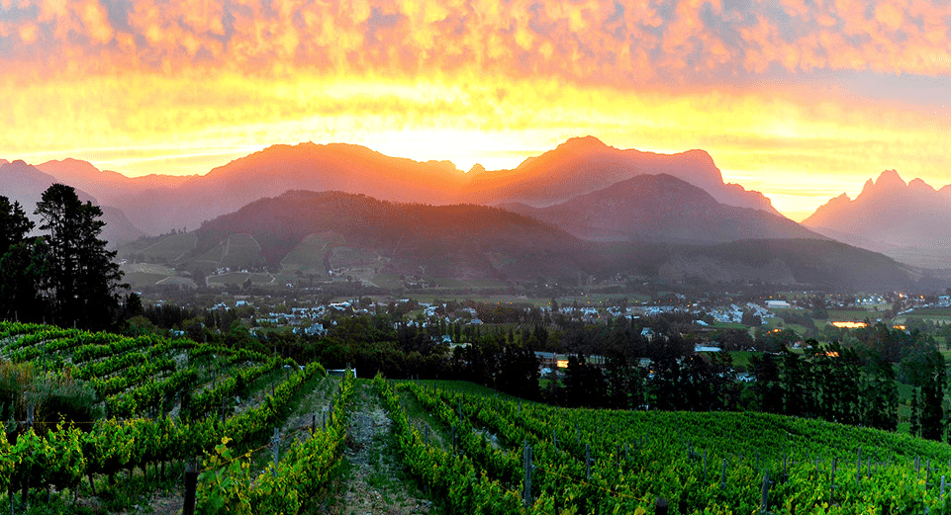
One Cape Winelands campus. Six tenants. One non-profit holding company.
WEGROYOU FRANSCHHOEK CAMPUS · 60 MINUTES FROM CAPE TOWN INTERNATIONAL

Slide 3
0.0 · CONTENTS
Table of Contents
1.0
The campus & the promise
6.0
Reinventing sport
2.0
Why Franschhoek, why now
7.0
Medical Rehab + SwimCo
3.0
Governance — the NPC model
8.0
Tourism as demand engine
4.0
The six verticals
9.0
Financials & funding
5.0
Sport-tech incubator
10.0
The ask

Slide 4
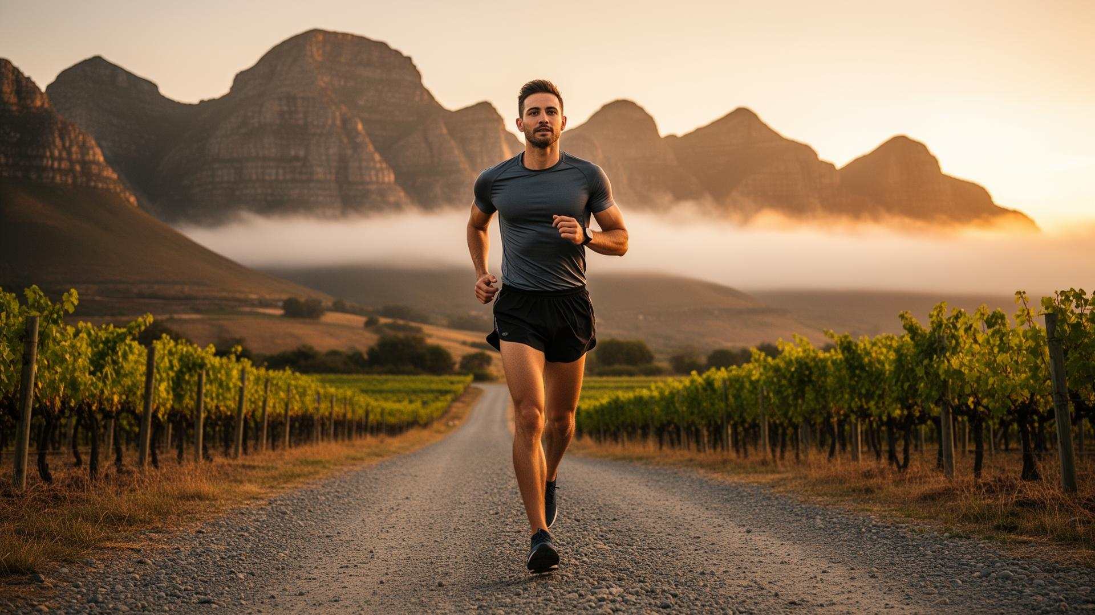
1.0
THE CAMPUS & THE PROMISE

Slide 5
1.1 · THE CAMPUS
A Cape Winelands campus engineered as a multi-tenant operating system.
One destination. Six tenants. One operating model.
Located on the historic Franschhoek High School grounds — 15 Union Street, Franschhoek.
Olympic-standard infrastructure: 50m FINA-spec heated outdoor pool, athletics track, rugby field, gym, residential, academic.
Six operating tenants under one NPC. HOA-style governance. Shared services across the board.
Built as part of the wegro.africa ecosystem — sport, food, nature, wellness and venture-building under one roof.
Cape Town competes. Franschhoek recovers, trains, creates and ships.

Slide 6
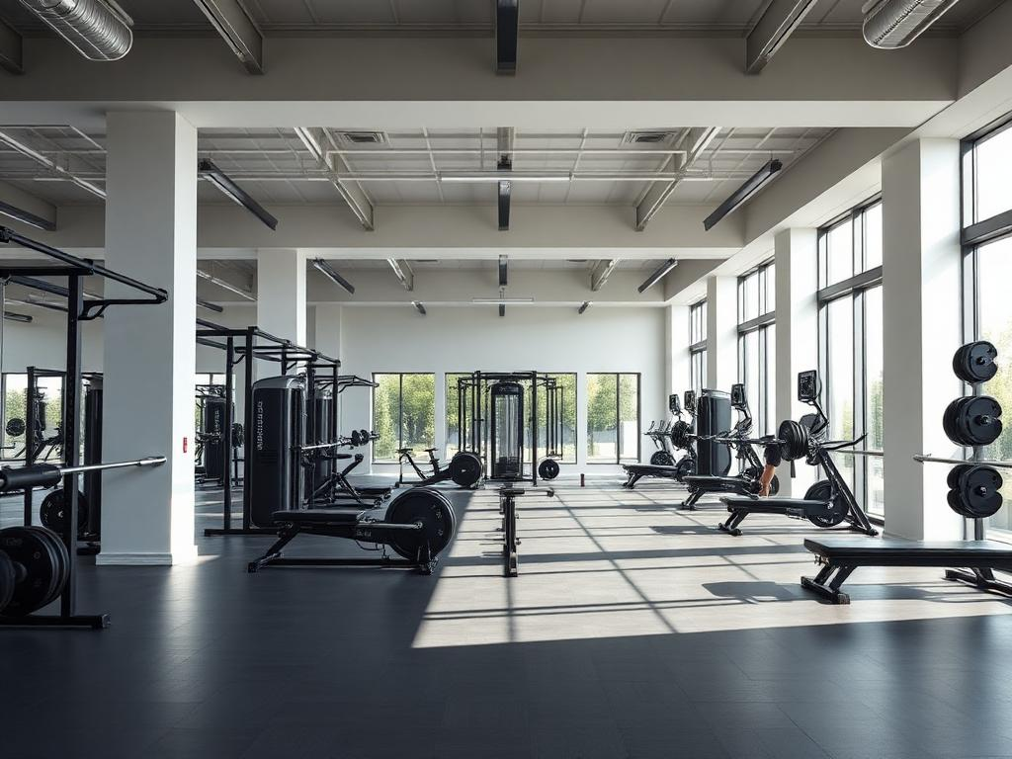
1.2 · THE SHIFT
Pure physical training is being replaced by holistic high-performance.
The world's leading sport centres are no longer training facilities.
They are integrated daily training environments — sport medicine, sport science, recovery, nutrition, psychology, education and accommodation under one roof.
Margins between success and failure shrink each year. The supporting environment is the difference.
WeGroYou adopts the global high-performance model and extends it across food, nature, water-rehab, tourism and venture-building.
The campus becomes a permanent R&D environment — a testbed, not just a venue.

Slide 7
1.3 · LOCATION
60 minutes from Cape Town. A century of sport, food and wine.
Franschhoek is the Cape Winelands' most distinctive village — and a global tourism brand.
Year-round visitor demand from Cape Town International — the operational gateway to Africa.
Existing accommodation, F&B and hospitality density that no greenfield site can match.
Adjacent to the historic Franschhoek High School — the site that anchors the campus.
South Africa is a rising medical-tourism hub. The Cape is the recovery destination.

Slide 8
1.4 · THE CAMPUS
The numbers behind the timing.
Why Franschhoek, why now.
60
6
10
365
MINUTES TO CPT
TENANTS, 1 LEASE
FINA LANES
DAYS OF DEMAND
From Cape Town International. The operational gateway to the campus.
Six operating tenants under one NPC master lease. HOA-style governance.
50m FINA-specification heated outdoor pool. Africa's leading aquatic asset.
Cape Winelands tourism keeps the campus working year-round.
Source: Wegro Cape Town tourism stats, FINA pool specifications, internal model

Slide 9
2.0
WHY FRANSCHHOEK, WHY NOW

Slide 10

2.1 · WHY NOW
The convergence is happening this decade.
Five tailwinds — converging on one Cape Winelands campus.
African sport is professionalising — federations, athletes and brands need a permanent high-performance home.
Medical tourism into South Africa is growing 8–12% per year. The Cape is the destination.
Hospitality demand in Franschhoek is structurally undersupplied year-round.
Foodtech, sport-tech and creator economy ventures need physical R&D environments — not just co-working space.
The wegro.africa ecosystem and tokenized capital rails make the campus financeable in a way that wasn't possible 5 years ago.

Slide 11
2.2 · WHY NOW
The Cape's tourism + medical engine.
The demand pool the campus plugs into.
11M
8–12%
R28B
82%
CPT ARRIVALS 2025
MED-TOURISM CAGR
WC TOURISM SPEND
FRANSCHHOEK OCC.
Cape Town International annual passengers, recovering above pre-COVID baseline.
South Africa inbound medical tourism, 2020–2030 estimate.
Western Cape annual tourism revenue, latest Wesgro.
Year-round average hospitality occupancy, top of Cape rankings.
Source: Wesgro 2024 tourism review, SA Tourism medical tourism brief 2024

Slide 12
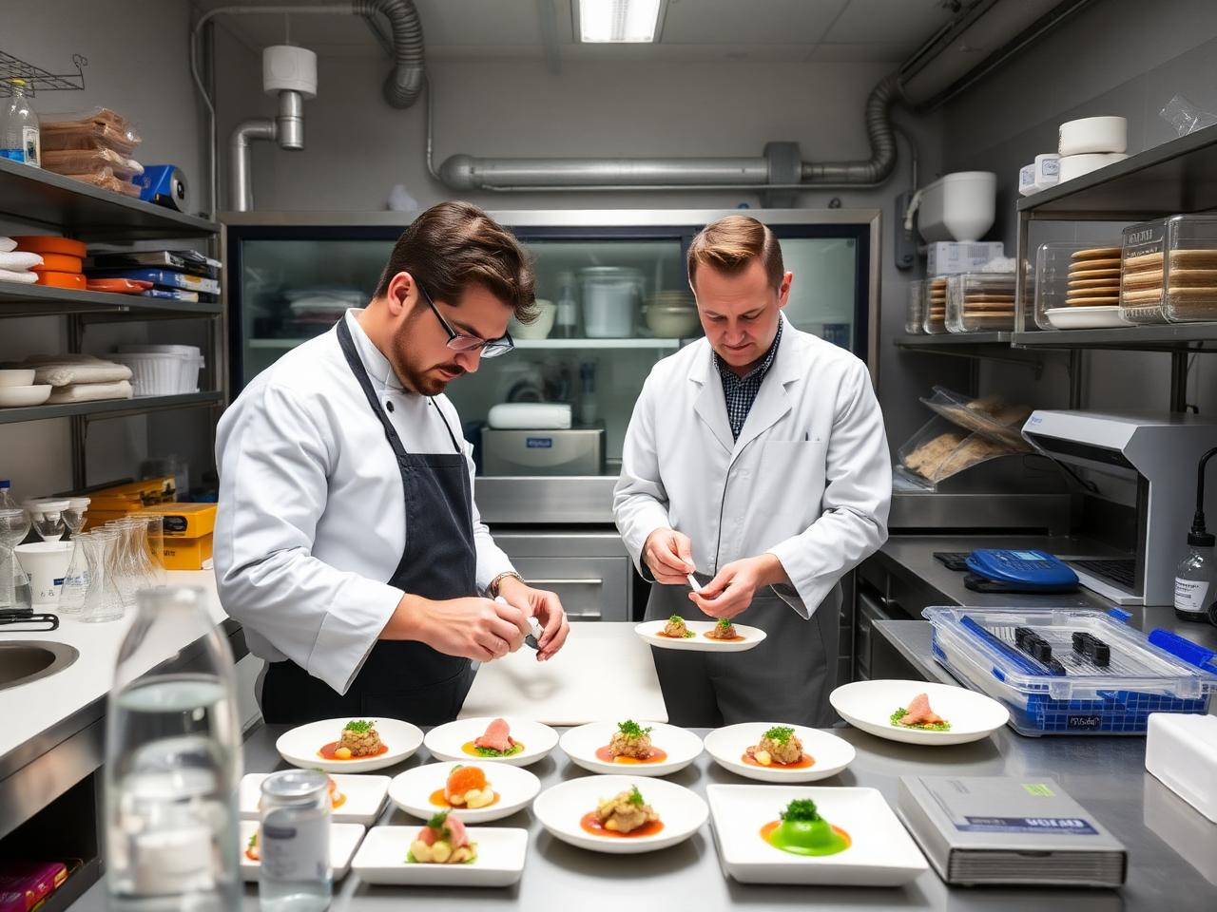
3.0
GOVERNANCE — THE NPC MODEL

Slide 13
3.1 · GOVERNANCE
WeGroYou NPC — asset holder & master lessor
HOA-style governance — patient capital owns the campus, tenants run the verticals.
WEGROYOU NPC · ASSET HOLDING · MASTER LEASE
OPERATING TENANTS · LONG-TERM LEASES FROM THE NPC
NXT Sportif
NXT Chefs
NXT Rangers
SwimCo + Medical Rehab
Wegro Ventures
StayCo
SHARED SERVICES · SALES & MARKETING · FINANCE & ADMIN · OPERATIONS & FACILITIES
All operating surplus flows back into campus infrastructure and the Wegro Ventures incubator pool — for-profits cannot access this funding pathway.

Slide 14
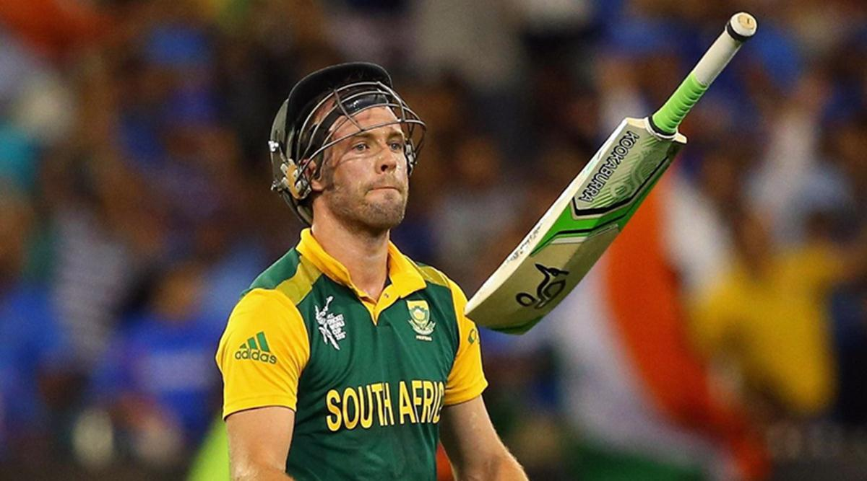
3.2 · GOVERNANCE
The NPC owns. Tenants operate.
Patient capital owns the bricks. Best-in-class operators run the verticals.
WeGroYou NPC = asset-holding non-profit. Long-term campus lease ceded from Traincamp.
Six operating tenants take long-term sub-leases from the NPC: Sportif, Chefs, Rangers, SwimCo, Ventures, StayCo.
HOA-style board: NPC + tenant operators + community + Olympic / FINA / federation reps.
Surplus is reinvested into campus infrastructure and the Wegro Ventures incubator pool — for-profits cannot access this.
This unlocks DTI, Lottery, Sport & Recreation SA and corporate-CSI funding that for-profits cannot access.

Slide 15

3.3 · GOVERNANCE
Why the HOA-style works.
Six tenants, one shared interest in the campus succeeding.
Tenants depend on each other — Chefs feeds Sportif, SwimCo recovers Rangers, Ventures invests in athletes.
Shared services (sales, marketing, finance, ops, facilities) cut overhead by ~40% versus six standalone operators.
Single F&B, accommodation and event-management operator (StayCo) keeps guest experience unified.
NPC board prevents any one tenant capturing the campus — and keeps the long-term mission intact.
Mirrors the global FIFA / Olympic 'commune sportive' model that has worked in France for 30 years.

Slide 16
4.0
THE SIX VERTICALS

Slide 17
4.1 · NXT SPORTIF
Olympic-standard sport — and a permanent R&D lab for what sport becomes next.
Africa's first FINA HPC sister-site. The campus is the testbed.
Primary codes: swimming (FINA-spec), athletics, rugby. 3rd-party access: boxing, tennis, cycling, rowing, canoeing, triathlon.
Residential athlete development from regional through national to federation training camps. Pre-event acclimatisation.
Community membership keeps the centre full year-round. Sports tourism feeds peak weeks.
Doubles as a sport-tech incubator: wearables, performance analytics, fan economy, hybrid league formats, athlete-owned IP.
Africa's launchpad for new up-and-coming Olympic talent.

Slide 18

4.2 · NXT CHEFS
A food lab that feeds athletes, guests, patients and the next generation of chefs.
The food capital of South Africa needs a teaching kitchen.
Sports nutrition kitchen: meal plans for resident athletes, training camps, recovery patients.
Chef school accredited for hospitality training — feeding the Cape's restaurant industry with talent.
Longevity & wellness menus tied into the Medical Rehab and StayCo guest stays.
Public-facing NXT Cafe on the campus — community revenue and local visibility.
Cross-sells nutrition IP into Wegro Ventures food-tech startups.

Slide 19
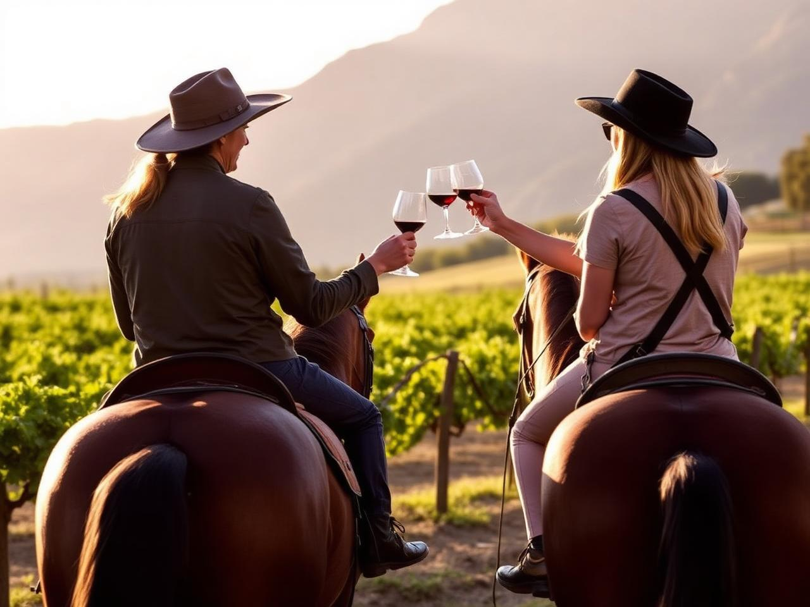
4.3 · NXT RANGERS
The Cape Winelands as the campus's outdoor extension.
A guide and ranger academy — partnered with Will of Africa (25,000+ trained).
Trail running, mountain bike, horseback, vineyard walks, 4x4 routes, conservation experiences.
Recovery walks for Medical Rehab patients. Easy nature access for longevity guests.
Athlete cross-training: trail for runners, MTB for cyclists, horseback for core and balance.
Operated in partnership with surrounding farms, conservancies and tourism operators.
Fully aligned with wegro.africa's nature pillar.

Slide 20
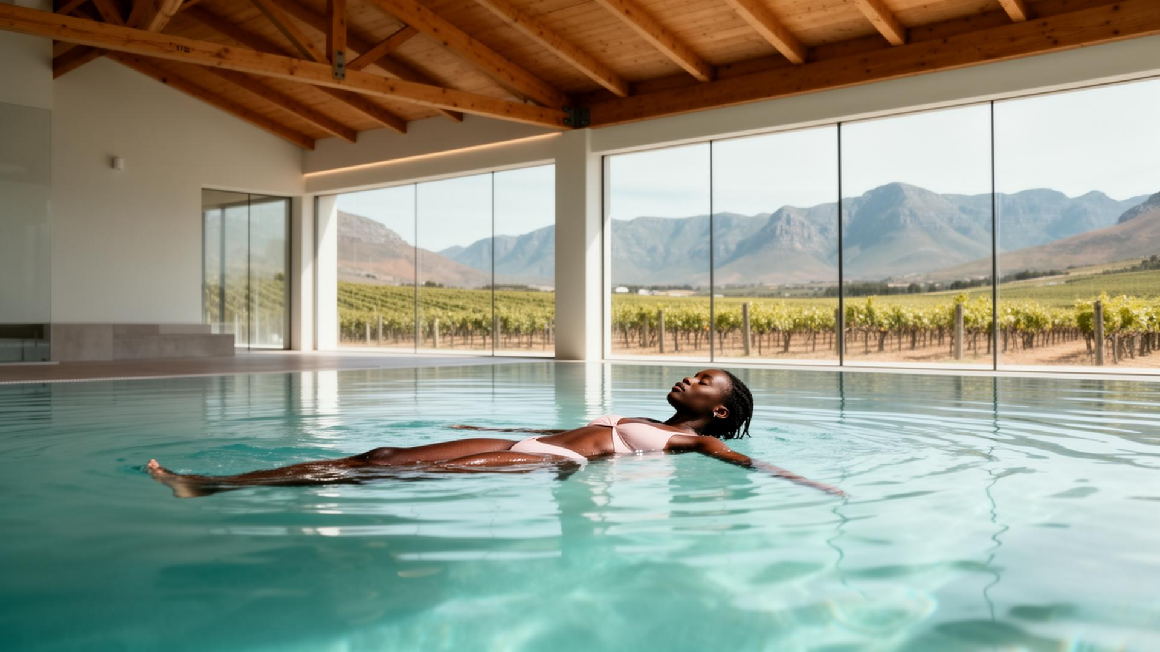
4.4 · SWIMCO + MEDICAL REHAB
The pool isn't a cost centre. It's a clinic, a club and a destination.
An Olympic pool used 20 hours a week is a stranded asset. Ours runs 168.
SwimCo operates the aquatic centre under the NPC lease. All revenue, all responsibility.
Six water revenue streams: clinical hydrotherapy, athlete rehab, water polo, aqua-fitness, recovery suites, specialist water sports.
Medical tourism flow: Cape Town surgery → Franschhoek recovery → optional Winelands holiday.
Multi-year offtake from hospital groups, medical schemes and insurers.
Compounds across StayCo (bednights), Chefs (clinical nutrition), Sportif (athlete recovery), Ventures (health-tech testbed).

Slide 21

4.5 · WEGRO VENTURES
The campus is a permanent venture studio.
Foodtech and sport-tech are the two USPs no other accelerator can match.
Sport-tech specialism: performance, wearables, fan economy, hybrid leagues, creator-physical crossovers.
Adjacent specialisms: longevity, water-rehab tech, food-tech, rural-tech, hospitality-tech.
Live testbed advantage — every startup can deploy on a working campus from day one.
Builds, invests in and operates new ventures with founders. Equity flows back to the NPC pool.
Direct overlap with NXT Sportif as the campus's R&D engine.

Slide 22
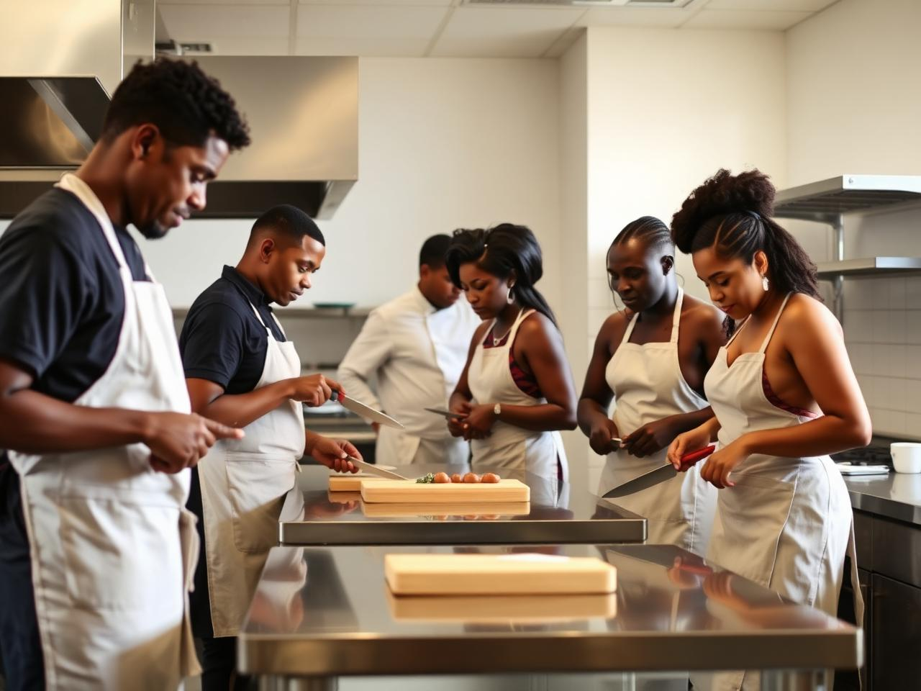
4.6 · STAYCO (HOSPITALITY)
The bednight is the unit of demand.
Residential athlete accommodation + short-stay 1- and 4-star configurations.
Federation training camps, pre-event teams, medical-tourism recovery guests, conference delegates.
Tied into the Cape Winelands tourism cluster — the campus benefits from existing visitor demand.
Cross-sells F&B (Chefs), water (SwimCo), nature (Rangers), event hosting (Sportif).
Operated as a single tenant for unified guest experience across the campus.
The bednight metric is what every other vertical compounds against.

Slide 23
5.0
SPORT-TECH INCUBATOR

Slide 24
5.1 · SPORT-TECH INCUBATOR
Six tracks. One live testbed.
What the campus invents — and ships.
PERFORMANCE TECH
FAN ECONOMY
RECOVERY & LONGEVITY
Wearables, biomechanics, GPS/video analysis. Deployed on resident athletes, validated by HPSISA-grade coaching.
Direct-to-fan platforms, athlete-owned IP, creator-physical crossovers. Built for the post-broadcast era.
Water-rehab tech, sleep, nutrition. Tested on athletes AND medical-tourism guests.
HYBRID FORMATS
FOOD-TECH
RURAL & WINELANDS-TECH
Reinventing sport itself: shorter formats, mixed disciplines, new league economics. The campus is a venue and lab.
Sports nutrition + longevity menus + Cape produce. NXT Chefs is the in-house validation kitchen.
Tourism-tech, hospitality-tech, vineyard-tech. Built where the customer already is.

Slide 25
5.2 · SPORT-TECH INCUBATOR
Why this campus is the lab — not Stellenbosch, not Cape Town.
Three things only this campus can offer sport-tech founders.
Live athletes on tap — federation camps, residential talent, community members. Not focus groups.
Olympic-grade infrastructure already in place — pool, track, gym, biomechanics suite.
A foodtech lab and chef school next door — unique in any sport-tech ecosystem globally.
Adjacent to medical rehab and longevity tenants — cross-pollination unavailable in any pure sport facility.
NPC governance keeps founder equity clean: campus access in exchange for testbed data, not cap-table share.

Slide 26
6.0
REINVENTING SPORT

Slide 27
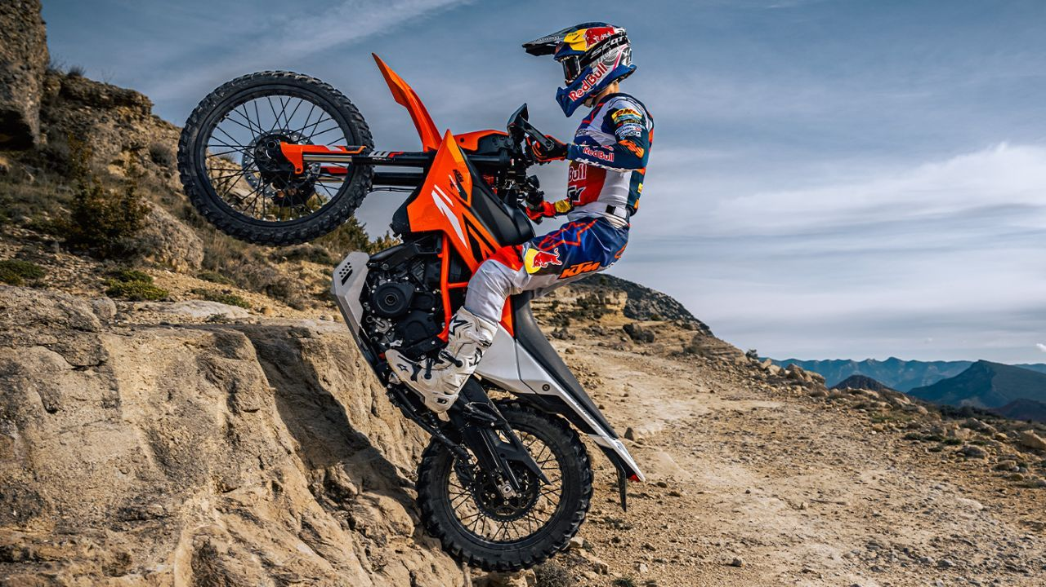
6.1 · REINVENTING SPORT
Sport has changed every era. We're in the biggest shift since broadcast.
The campus is built to invent and incubate the formats, leagues and businesses this era demands.
Roman games → Victorian codification → broadcast era → streaming era → attention economy.
Behavioural shift: shorter formats, second-screen consumption, athlete-as-creator, fan-as-stakeholder.
Time pressure: traditional 3-hour formats compete with TikTok, gaming, fragmented attention.
Money flows shift: sponsorship and broadcast rights move toward direct-to-fan and creator economics.
Whoever builds the next league formats will own a generation of attention — the campus is built to ship them.

Slide 28
7.0
MEDICAL REHAB + SWIMCO

Slide 29
7.1 · WATER STRATEGY
An Olympic pool used 168 hours a week, not 20.
Repurposing the most expensive single asset on the campus.
Competitive swimming alone uses ~20h/week of an Olympic-grade pool. The other 148h is dead capital.
Medical Rehab fills the gap: hydrotherapy, post-op orthopaedic recovery, athlete rehab, contrast suites.
Schools and clubs: Cape water polo, free-diving, lifesaving, masters squads pay for block bookings.
Aqua-fitness and community membership keep daily revenue flowing.
Result: SwimCo moves from subsidised community pool to a stand-alone tenant business with hospital offtake.

Slide 30
7.2 · MEDICAL REHAB + SWIMCO
Cape Town operates. Franschhoek recovers.
A four-step medical tourism funnel that anchors SwimCo's revenue with off-peak hospital offtake.
01
→
02
→
03
→
04
INBOUND
TRANSFER
REHAB
DISCHARGE
International patient lands in Cape Town. Procedure at network private hospital.
60-min transfer to Franschhoek campus. StayCo bednights.
Daily hydrotherapy + physio at SwimCo. Recovery nutrition from NXT Chefs.
Sign-off back to Cape Town hospital, or fly home. Annual follow-up = repeat tourism.

Slide 31
8.0
TOURISM AS DEMAND ENGINE

Slide 32
8.1 · TOURISM
Tourism isn't a vertical. It's the demand engine that fills every vertical.
Every guest stay generates demand across StayCo + Chefs + SwimCo + Rangers + Sportif.
Cape Winelands tourism is year-round, high-spend and globally branded.
Sports tourism: training camps, masters meets, gala events, MTB & trail festivals.
Medical tourism: surgery + recovery packaged as a Cape Winelands stay.
Lifestyle tourism: longevity guests, hospitality training, culinary tourism via NXT Chefs.
The campus monetises tourism six ways without becoming a hotel.

Slide 33
9.0
FINANCIALS & FUNDING

Slide 34
9.1 · FINANCIALS
Six revenue lines compounding under one operating model.
Year-3 base case across all six tenants.
R171m
28%
R65m
5 yrs
REVENUE
EBITDA
CAPITAL
PAYBACK
Year-3 base case, blended across all six tenants.
Margin once tenants reach steady state.
Working capital, incubator pool and GTM combined.
Conservative payback on the campus capex.
Source: Detailed model available — see WeGroYou Model base 2025 .xlsx. Downside, base and upside scenarios with AI commentary.

Slide 35
9.2 · FUNDING
Capital sources only an NPC can unlock.
Funding sources for-profit operators cannot reach.
Government / DTI / Sport & Recreation SA — accessible because the NPC is non-profit.
Federation funding: SwimSA, Athletics SA, FINA-aligned development funding for the aquatic centre.
Corporate sponsorship + CSI — unified Team-South-Africa-style proposition is more marketable than fragmented bodies.
Foundation funding (e.g. Princess Charlene, Olympic Foundation) for athlete development.
Hospital and insurer offtake contracts for the Medical Rehab vertical.
Equity capital from impact investors for the Wegro Ventures incubator pool.

Slide 36
10.0
THE ASK

Slide 37
10.1 · THE ASK
What the round buys.
R65m to bring the campus to operational steady state and seed the venture incubator.
R28m
R15m
R12m
R10m
CAPEX
WORKING CAPITAL
INCUBATOR POOL
GTM
Aquatic centre upgrades, gym fit-out, residential refurb, NXT Cafe build-out.
First 18 months of NPC + tenant working capital while revenue ramps.
Wegro Ventures first-cohort investments — sport-tech, foodtech, longevity.
Tourism, federation, hospital and corporate partner GTM spend.
Source: Use-of-funds detail available in the financial model workbook.

Slide 38
10.2 · THE ASK
What partners get.
A seat at the campus that becomes a permanent African export.
Direct allocation in the Wegro Ventures incubator pool — first-cohort venture co-investment rights.
Naming rights to facilities (aquatic centre, gym, chef school, residences) for foundational partners.
Federation co-development seat on the NPC board for sport-body partners.
Hospital and insurer offtake contracts at preferential SwimCo / Medical Rehab rates.
Brand association with the wegro.africa ecosystem and the Cape Winelands tourism cluster.

Slide 39
WWW.WEGRO.AFRICA · HELLO@WEGROYOU.COM
For NXT level humans.
WEGROYOU FRANSCHHOEK CAMPUS · 60 MINUTES FROM CAPE TOWN INTERNATIONAL

